Slide 1


Evaluations of Updated Terra Day/Night Rate
Before October 5th: 50/50 BAP (baseline activity profile) set the formatter day/night rate to coincide with the MODIS terminator crossing
October 5th: PWA anomaly reduced the on-board data storage allocation requiring a reduction in the MODIS data rate.
October 7th @ 20:00: Adjusted BAP implemented, reducing the day rate data by ~6:00 equally from north/south poles
November 8th: STS (short-term schedule) method of day/night rate began. Using 4-orbit method, the reduced data rate is shifted per orbit to gain better polar coverage.
Important notes: The polar coverage is dependent on seasonal variations due to sun angle. For example, the north pole has areas with no sunlight from October to March. At the same time, the south pole has overlapping coverage.
Based on NOAA_Solar_Calculations_Year at 65 deg Latitude. (https://www.esrl.noaa.gov/gmd/grad/solcalc/calcdetails.html)
Page 1
Notes:
1

Slide 2
Proposing a Change
In order to facilitate greater coverage over the poles we propose updating the formatter scheduling.
Using the derived solar angle throughout the year, adjust the alternating orbits to focus on the North Pole during from October - March and South Pole April - September
~+3:00
~+3:00
variable
~+3:00
variable
~+6:00
~+3:00
~+3:00
~+3:00
~+6:00
~+3:00
~+3:00
Current STS
Proposed STS
1 = Focused on North Pole
~+6:00
0.8 = Toward North Pole
~+2:00
~+4:00
0 = Focused on South Pole
~+6:00
Page 2
Notes:
2

Slide 3
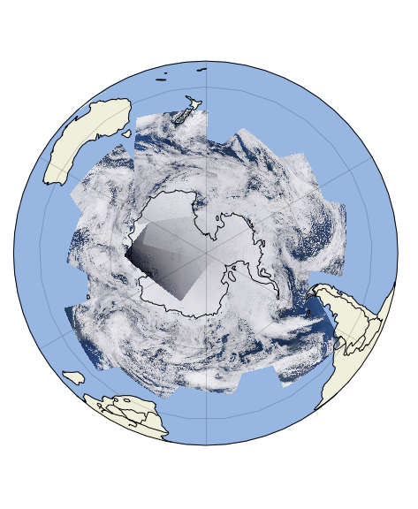
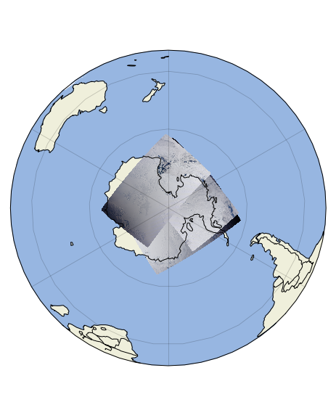
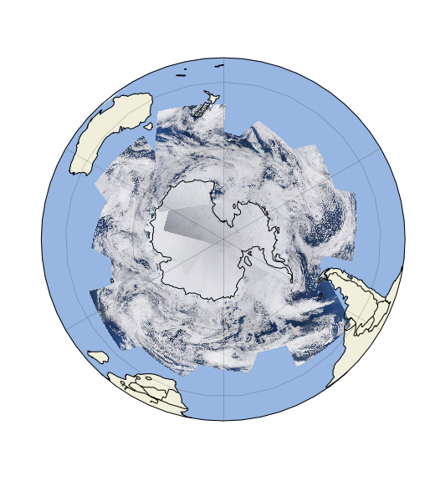
Proposing a Change - Example
For example: The largest change will be seen during each solstice.
Shown is observed L1B day rate data counts converted to RGB (Bands 1, 4, and 3) from December 21, 2020 over the South Pole. This corresponds to day 356 in plots on previous slide.
Due to the sun angle at this time of year, the terminator occurs after the spacecraft has passed over the pole for each orbit, creating significant overlapping of day rate data.
The proposed STS would remove 5:56 seconds of day rate data from the end of 3 orbits on this day.
Please refer to the Notes area of the slide for details on how the data was processed.
Current STS
Removed data from Proposed STS
Simulated Proposed STS (no loss in coverage)
Page 3
Notes:
3
Only granules within 15 mins of the day/night transition are shown to reduce data processing time. Data is plotted according to time, so newer data overlaps older data. For added margin and ease of presentation, more than 5:56 have been removed from each orbit with no loss in coverage due to overlapping observations. I did not incorporate reflectance scale values into the data, just counts. Black areas are caused by partially illuminated scans.

Slide 4
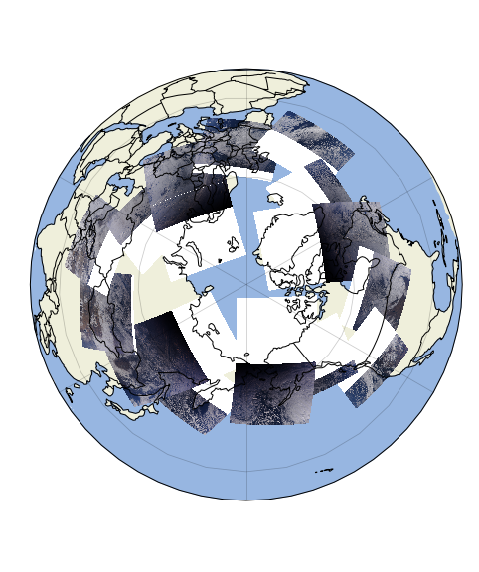
Proposing a Change - Example
The benefit of the proposed change would add coverage on the opposite pole.
Green areas would be added with day rate coverage using proposed STS schedule.
Current STS
Proposed STS – Green areas of added day rate data
Page 4
Notes:
4
White areas are plotting artifact, no day rate data.

Slide 5
Proposing a Change - Updates
Full 50/50 BAP has timing based on Nadir terminator crossing
STS uses delta times from Nadir terminator crossing to determine day rate start and end times (all times shown as MM:SS)
The current STS is fixed using 4 orbit cycle.
Orbit 1 and Orbit 3 day rate starts 2:58 after terminator crossing to day, ends 2:58 before terminator crossing to night
Orbit 2 day rate starts 5:56 after terminator crossing to day, ends at terminator crossing to night
Orbit 4 day rate starts at terminator crossing to day, ends 5:56 before terminator crossing to night
Page 5
Notes:
5
White areas are plotting artifact, no day rate data.

Slide 6

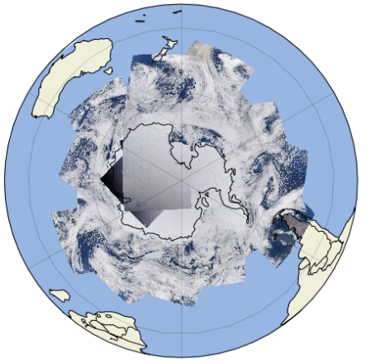
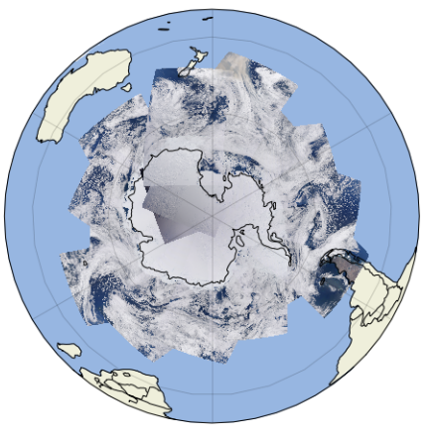
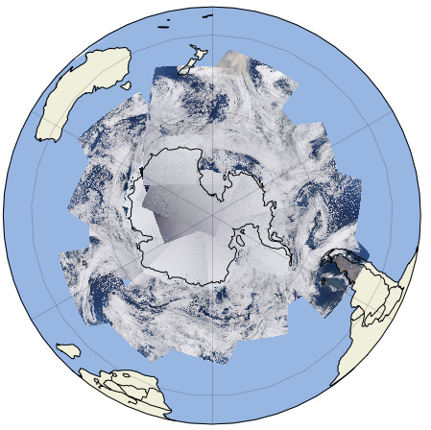
Proposing a Change – Day 2020/001
The proposed STS change uses an adjusting schedule for Orbits 2 and 4 based on sun angle throughout the year.
For day 2020/001
Orbit 1 and Orbit 3 day rate starts 2:58 after terminator crossing to day, ends 2:58 before terminator crossing to night
Orbit 2 day rate starts 0:47 after terminator crossing to day, ends 5:09 before terminator crossing to night
Orbit 4 day rate starts at terminator crossing to day, ends 5:56 before terminator crossing to night
This day has four orbits that match the Orbit 2 schedule, shifting 5:09 towards the North Pole four times
Full BAP
Current STS (simulated)
Proposed STS (simulated)
Page 6
Notes:
6
South Pole data has granules removed to simulate day rate reduction. Simulated North Pole has data removed manually based on expected orbit timing for current and proposed STS day rate changes.

Slide 7
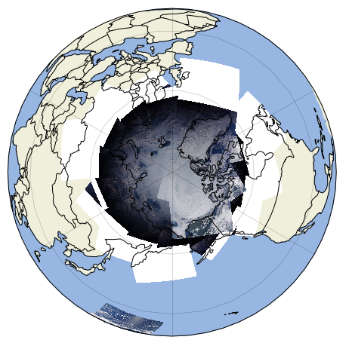

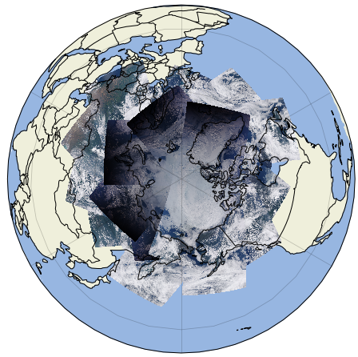
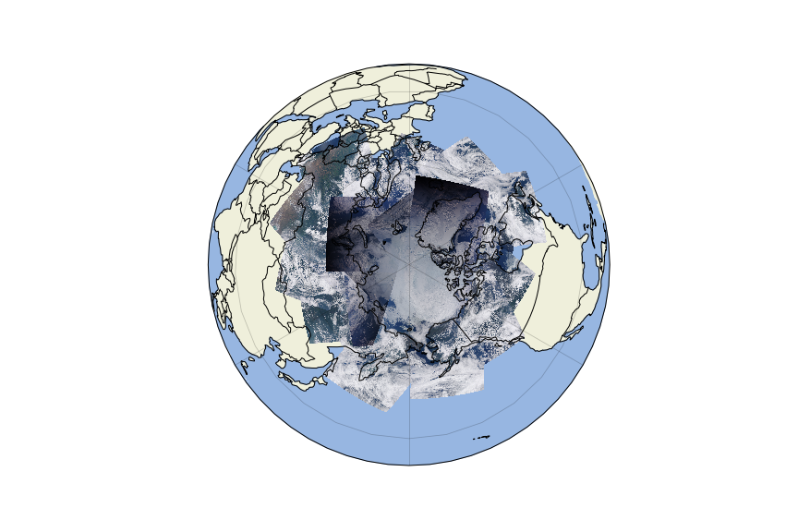
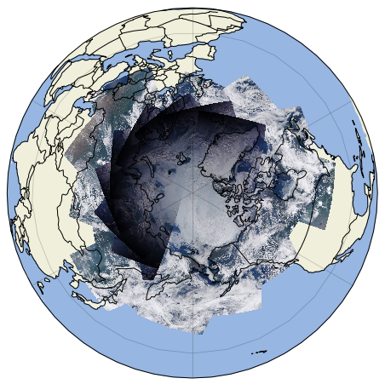
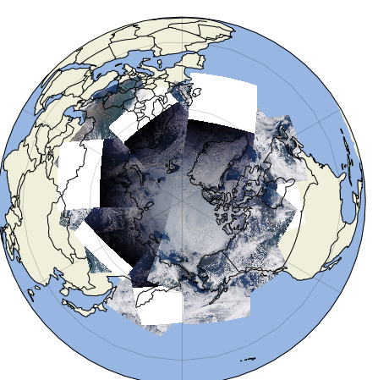
Proposing a Change – Day 2020/193
The proposed STS change uses an adjusting schedule for Orbits 2 and 4 based on sun angle throughout the year.
For day 2020/193
Orbit 1 and Orbit 3 day rate starts 2:58 after terminator crossing to day, ends 2:58 before terminator crossing to night
Orbit 2 day rate starts 5:56 after terminator crossing to day, ends at terminator crossing to night
Orbit 4 day rate starts 5:20 after terminator crossing to day, ends 0:36 before terminator crossing to night
This day has four orbits that match the Orbit 4 schedule, shifting 5:20 towards the South Pole four times.
Full BAP
Current STS (simulated)
Proposed STS (simulated)
Page 7
Notes:
7
North Pole data has granules removed to simulate day rate reduction. Simulated South Pole has data removed manually based on expected orbit timing for current and proposed STS day rate changes.

